Slide 1
“State of BES”
Col Kyle Reybitz
Deputy PEO
31 Jan 18

Slide 2
Agenda
BES Intro/Overview
HHQ Guidance
Business Capability Acquisition Cycle (BCAC)
BES Initiatives/Progress
Small Business

Slide 3
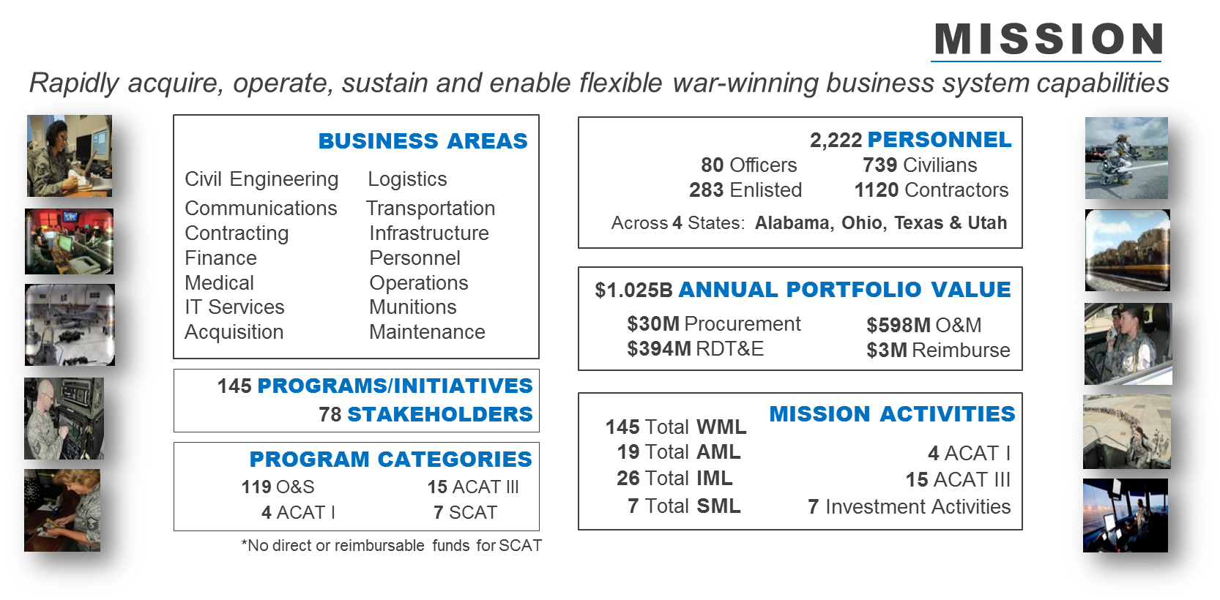
AFPEO BES Overview
WE run the SYSTEMS that run the AIR FORCE…moving MONEY, MANPOWER and MATERIEL

Slide 4
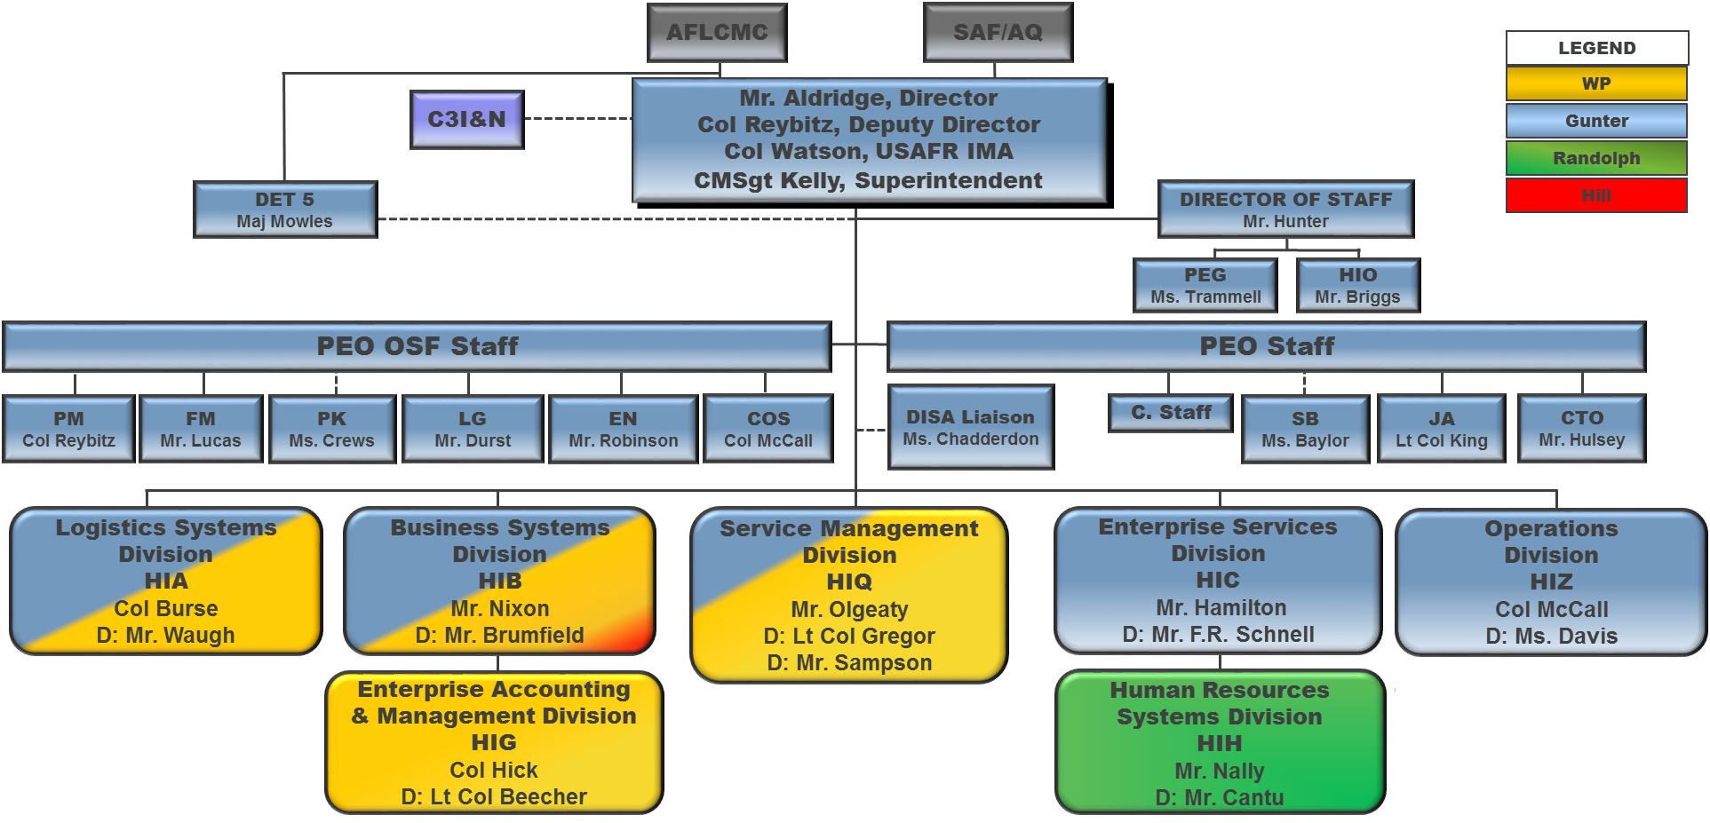
AFPEO BES Org Structure (Operational)

Slide 5
BES Strategic Goals
Goal 1 –Recruit, develop, & retain an agile workforce
Goal 2 –Strengthen Customer, Stakeholder and Industry Relationships
Goal 3: Drive flexibility & speed into our corporate processes
Goal 4: Remove non-value added policies & foster innovation through prototyping & incorporating disruptive technologies
Goal 5: Evolve to an adaptive organization structure; thereby, achieving flexibility & increasing mission effectiveness
Update Pending

Slide 6
SECDEF Guidance
5 Oct 17: Three Lines of Effort
First, restore military readiness as we build a more lethal force.
Second, strengthen alliances and attract new partners.
Third, bring business reforms to the Department of Defense. This line of effort instills budget discipline and effective resource management, develops a culture of rapid and meaningful innovation, streamlines requirements and acquisition processes, and promotes responsible risk taking and personal initiative. Some specific reforms are already in progress, such as the Congressionally-mandated creation of a Chief Management Officer and realignment of the Under Secretary of Defense for Acquisition, Technology and Logistics, as well as the Department's preparations for its first full-scope financial audit in FY 2018. Others are forthcoming, as we seek to modernize the defense travel system, protect our infrastructure and intellectual property, improve information technology business operations efficiency, and implement real cost accounting.

Slide 7
DEP SECDEF Guidance
27 Oct 17: Information Technology and Business System Reform
As part of NDAA FY17 Section 901
Reform efforts align functionally against 8 major lines of business
IT Reform Priority Areas (Current)
Reduce IT Commodity Sellers
Enterprise Collaboration Suite (ECAPS)
One NIPR/ One SIPR
Rationalize Business Systems (DCPS, DTS)
Consolidate Cyber/ IT Responsibilities
Accelerate Enterprise Cloud Adoption
IT Reform Priority Areas (as identified by Memo)
Time-phased roadmaps that evolve and deploys systems to support business reforms
Reduce total number of systems
Ensure systems have necessary controls to support audit and information integrity

Slide 8
SAF CIO High Priorities
DMZ Migration
Win 10 Migration
PKI Compliance
Privileged Access Management (PAM) is a virtual or hardened appliance/tool that performs strong 2 factor authentication (2FA) of privileged users as a proxy for legacy end devices

Slide 9
Other Ongoing HHQ Efforts
EITaaS (C3I&N)
JEDI (OSD)
ITCM (AFICA)
Agile “Everything” (MGen Zabel)
Data Mgmt (MGen Crider)
Bottleneck QRT (C3I&N)
Mobile (HAF/A4)
IT Approp/Working Captial Fund?

Slide 10
New DoDI 5000.75 Business Capability Acquisition Cycle
The reason behind the changes:
DoDI 5000.02 milestones, models and documentation did not provide the proper structure for managing business systems
In practice… tailoring for a business system often took too much time and effort, making it hard to justify the benefits it produced
The biggest differences from previous state of practice:
Alignment of acquisition, functional, infrastructure and IT investment governance to streamline decision-making
Information-centric approach to evaluating programs rather than reliance on acquisition and requirements documentation
Reflects elimination of statutory requirements for Major Automated Information Systems (repeal of title 10 Chapter 144A -- effective September 30, 2017)

Slide 11
BCAC Process Overview
Phase 1: Phase 2: Phase 3: Phase 4: Phase 5:
Capability Need Identification
Business Solution Analysis
Business System Functional Requirements
& Acquisition Planning
Business System Acquisition Testing & Deployment
Capability Support
Solution Analysis
ATP
Functional
Requirements ATP
Acquisition
ATP
Limited Deployment ATP(s)
Capability Support ATP
Full Deployment ATP
Ongoing Capability
Support ATP(s)
Activities/Products:
Identifies Business/Mission need
Capabilities to deliver business need
Performance Measures
BEA Alignment
Applicable Laws, Regulations & Policies (LRP)
Cost to complete next steps
Activities/Products:
Builds upon CRD
Develops “To-Be” Capability Process Maps (CPMs) for each business capability
Develops initial Capability Implementation Plan (CIP)
Determines rough order of magnitude (ROM) estimate and cost benefit
Activities/Products:
Identify/Define IT Functional Reqts (ITFRs) & Information Assets (IA)
Conduct Market Analysis
Acquisition Strategy Determination
Solution Approach Decision
Funding Identified
Activities/Products:
Solution Selection Decision
Detailed Fit-Gap Analysis
Develop Design Specifications
Establishment of Cost, Schedule, and Performance
Activities/Products:
Limited Deployment Testing Results
Full Operational Testing Results
Mature Software Capability
Transition and Sustainment Plan

Slide 12
BCAC Implementation Status
AFMAN 63-144 – Business Capability Requirements, Compliance, and System Acquisition
Under review with BCAC Working Group
Pending 2-ltr “re-coord”
BES Way-Ahead
Have a few systems in “hybrid” status to exercise the process
Developing instructional templates to support legacy systems
Community of Practice -- forthcoming
Updated information
Briefing Examples
Sustainment Documents

Slide 13
Other Ongoing HHQ Efforts

Slide 14
BES Agile Dev Initiatives at a glance
5 pilots selected at Feb 2017 Senior Leader agile on-site
AFWAY (HIC): Organic development w Ctr augmentation
OPA (HIH): Outsourced development, hybrid delivery team
MSAT (HIA): Outsourced, Fixed-Price Contract
NEXGEN (HIB): Outsourced, configuration of COTS solution
ARMS (HIB): Two dev teams – organic (sustain) and contractor (dev)
PBES (HIB) briefed as pilot during MITS (May 17)
Working well - Embraced Scrum Methodology; better collaboration between reqmnts owners and developers; joy of seeing results with every sprint
To improve - Speed requires more automated tests– need our BES contract developers to bring more automate unit testing of code, and their assistance to build automated end-user tests scripts
More investment in training – 13 members complete training for Scrum Master certification – counting on our Industry partners to match us!

Slide 15
BES Agile Acquisition Initiatives
FFP Software Maintenance
Invite to bid, draft to vendor pool, questions for 2 weeks, rapid award
Streamlined Source Selection
Points based Tech Experience and quantified Past Performance scoring
FFP Agile software development contract language
Included paragraph in PWS which allows the requirements list to change, under certain circumstances, without contract modifications. Specific language below:
"It is important to note that requirements may increase, decrease, or be modified as more information becomes available to the contractor and the government. These types of changes are expected as part of an agile approach, and shall not affect the cost or schedule…..”
Payment schedule based on devliery/acceptance of functional increments of capability
Although fixed price, negotiated payment schedule and specified within the CLIN description, which allows the contractor to bill 80% of the total value of the development for sprints, while the other 20% is reserved for delivery of major LDDs.
Competitive Range for Price
Oral Presentaitons w/ checklist for evaluation

Slide 16
BES Common Computing Environment Application Migration Update
CCE Overview
Multi-cloud framework– Amazon Web Services/Microsoft Azure w/ common services
Leveraging cloud native capabilities, maximizing PaaS and SaaS offerings
Adopting DevOps tools & infrastructure as code for continuous integration pipeline
CCE migration targeting hundreds of AF applications (initial focus on 25 BES GCSS apps)
Accomplishments
CCE 1.0: Initial migration of 6 GCSS Apps w/ production data in AWS (Nov 17)
Apps will be refactored to leverage CCE 2.0 cloud native services
CCE 2.0: Migration of 16 Apps for GCSS Sundown (testing complete by Mar 18)
13 apps being refactored and 3 apps undergoing initial analysis
Next Steps
CCE 2.0: 3 GCSS SIPR Apps/GCSS Data Services/Non-GCSS Apps (beyond Mar 18)
Focus On Migrating to CCE Capability As Rapidly As Possible

Slide 17
Mobile Application Technical Approach
Many mobile requirements identified—none approved and funded for BES to work
Can’t allow each PMO to develop unique approach to mobile app development
Developing standard BES approach to mobile application development out to hide
Small, BES part-time team researching using Gartner and MITRE support
Gathering requirements for mobile app development from existing AF mobile pilots
Development Tools
Operational Tools
Programmatic tools
Native vs Hybrid approach (some dependency on Portable Electronic Devices (PED) types across AF)
Measure requirements against AWS and Azure mobile service catalog
Part-time team in BES researching and developing Mobile Application Development Strategy—limited capability
Taking out of hide until receive funded requirements—planning to ask customers to share costs
Team plugged into AF and DoD Mobile policy working groups so programs don’t have to—standardize interpretation of guidance
BES Way Ahead: Working with contracting, legal and acquisition team to ID barriers to rapid acquisition and clear path for prototype efforts

Slide 18
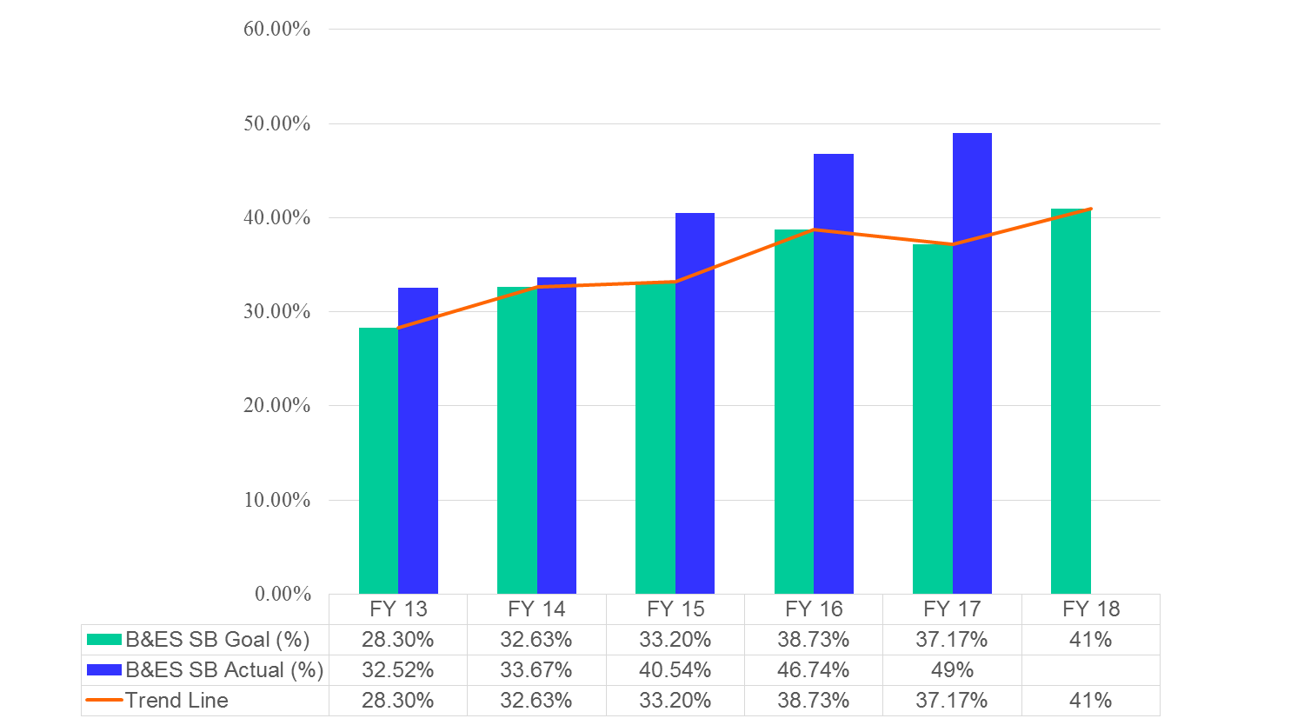
BES Small Business

Slide 19
BES SMART Reference Guide
Coming Soon

Slide 20
Questions

